Slide 1



V
November 27, 2024
My Weekly
Updates
Song-Ze, Yu

Slide 2
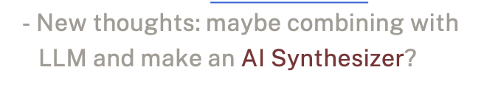
01
FAMILIARIZATION WITH MUSIC MAKING WORKFLOW
Quickly
Rewinds
02
KEEP LEARNING TECHNIQUES OF HOW TO MAKE A PLUGIN
These are goals I’m working on based
on the goal of making an AI plugin for the year.
03
OPEN VIEW TO NEW IDEAS

Slide 3
01
FAMILIARIZATION WITH MUSIC MAKING WORKFLOW
“Almost there”
02
KEEP LEARNING TECHNIQUES OF HOW TO MAKE A PLUGIN
Explore of Synthesizers
03
Math and Music? FPGA Synthesizer idea
“2018 劉奕汶 數位聲訊分析與合成”
OPEN VIEW TO NEW IDEAS

Slide 4
01
INTRODUCTION TO SYNTHESIZERS
02
Content
PYTHON IMPLEMENTATION AND DEMO
03
What I’ll cover today of things have learned and done these days.
Song-Ze, Yu
CONCEPTUAL FRAMEWORK FOR AN AI SYNTHESIZER

Slide 5
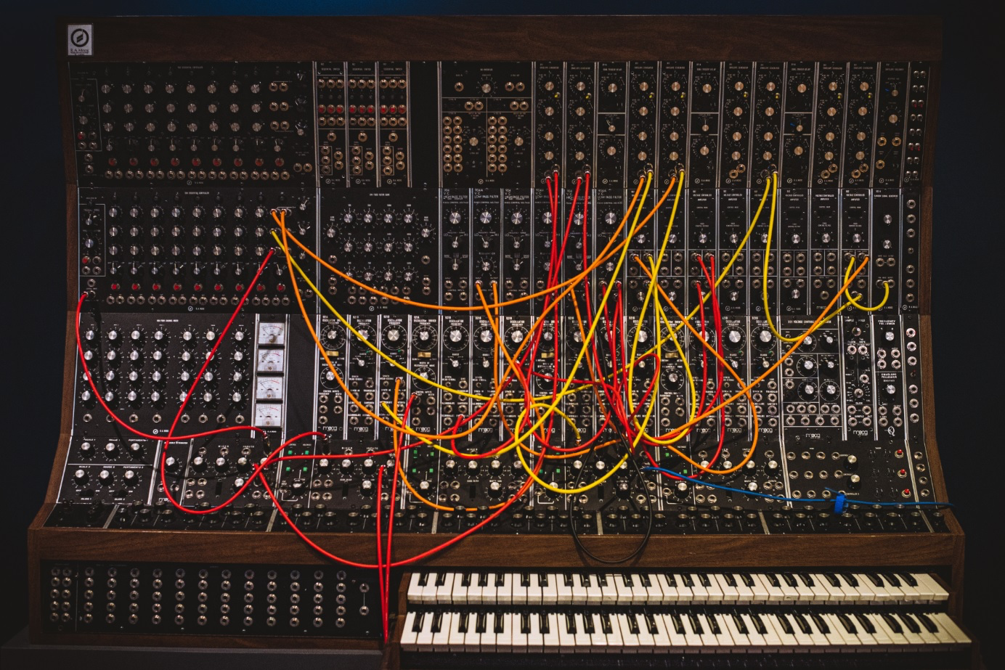
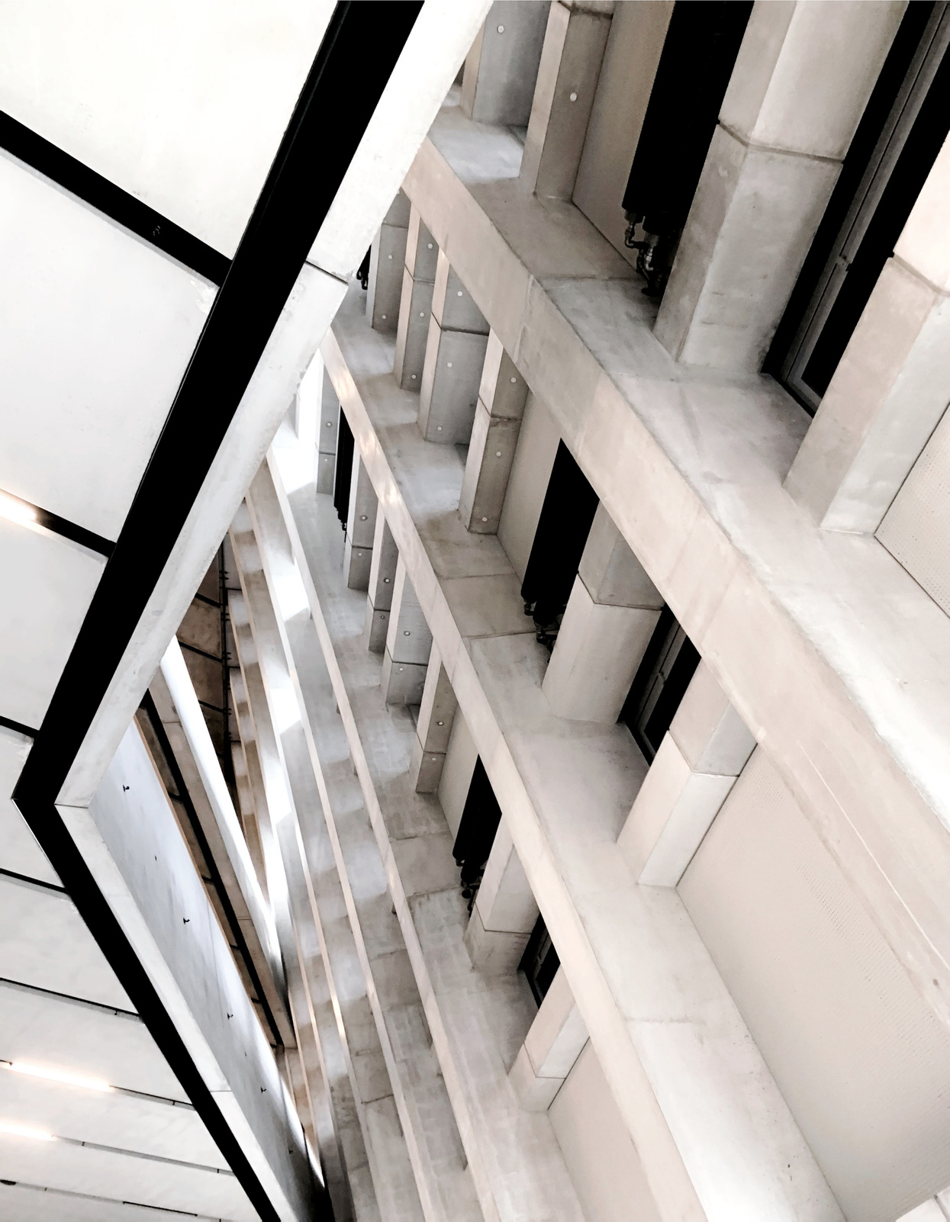
synthesizer v.s. keyboard
synthesizer v.s. sampler
01
an electronic instrument that generates and manipulates sound by creating and shaping waveforms.
What is a SYNTHESIZER?
Notes:
用電路產生或是數學算出來的聲音當成音色

Slide 6
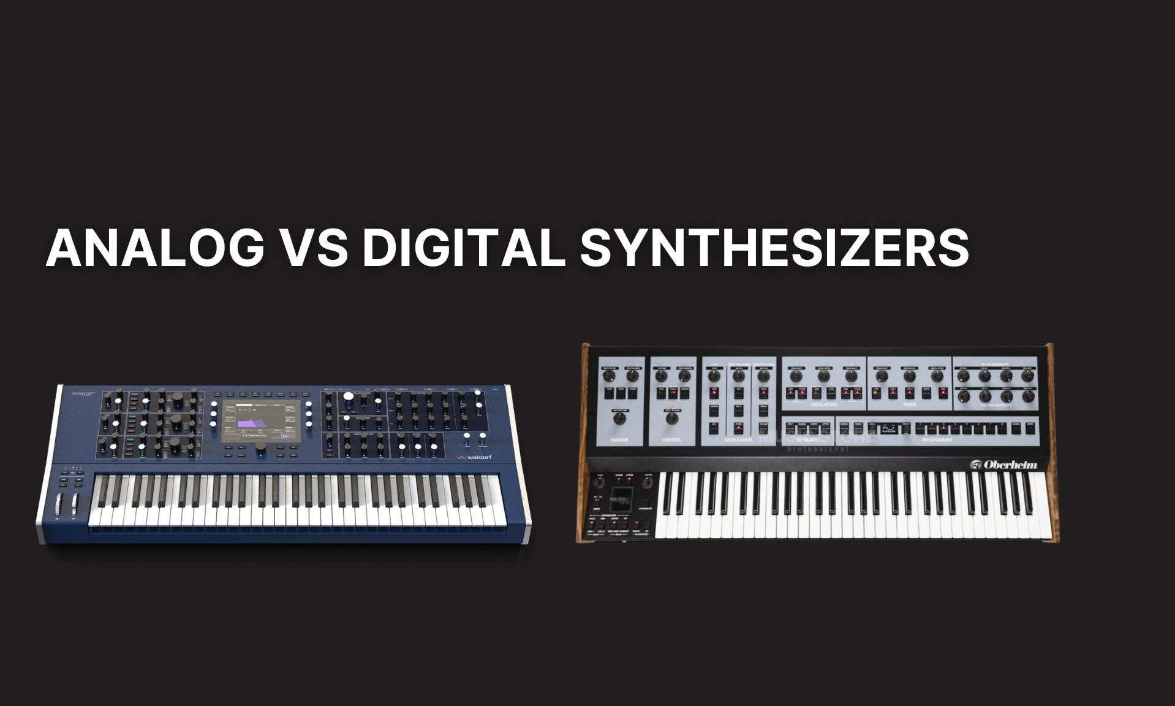
the sound is generated and processed entirely in the analog domain, resulting in a warm, rich, and organic tone. (limit: Polyphony)
generate and process sound using digital signal processing (DSP) algorithms and computer technology.

Slide 7
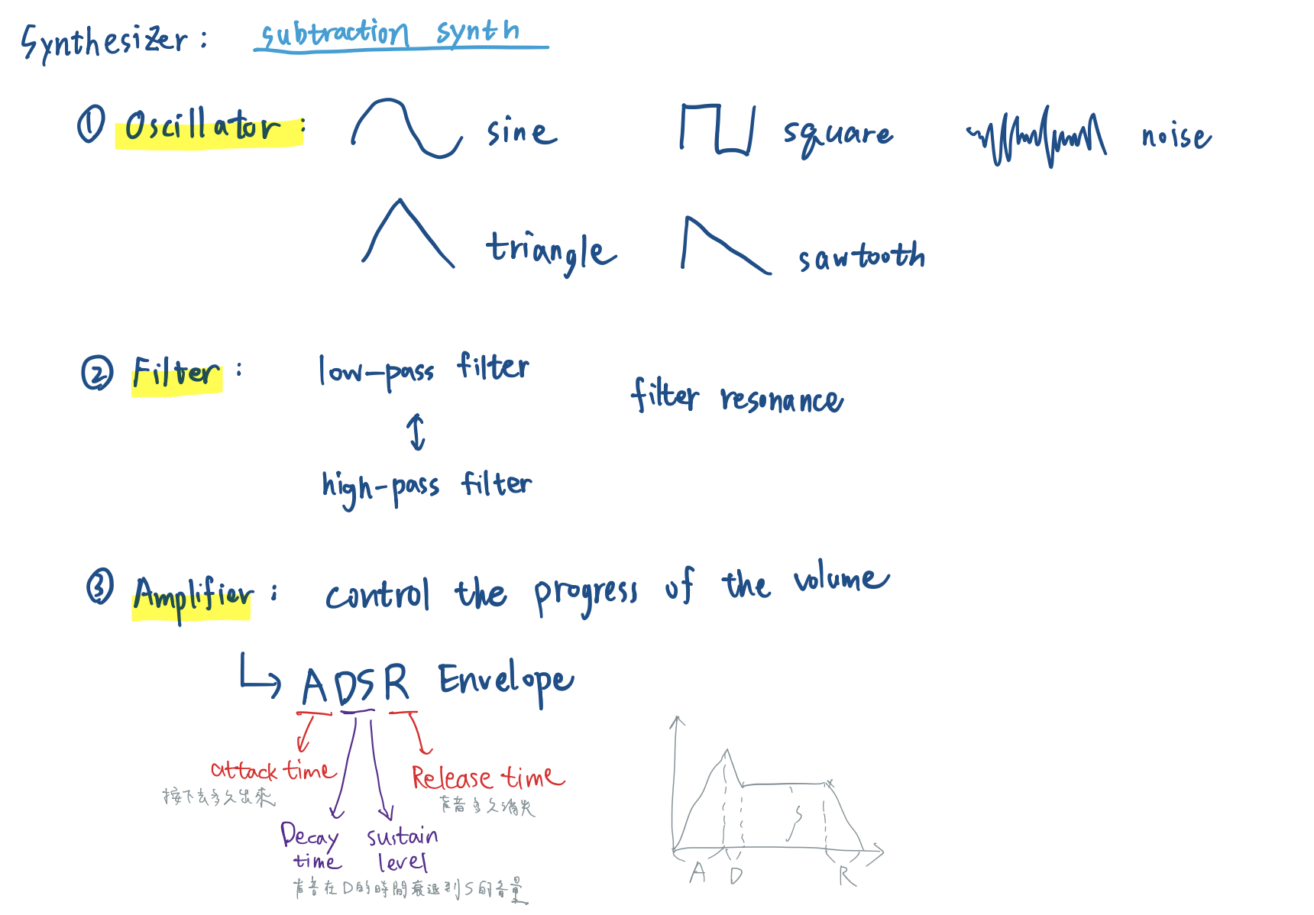

Slide 8

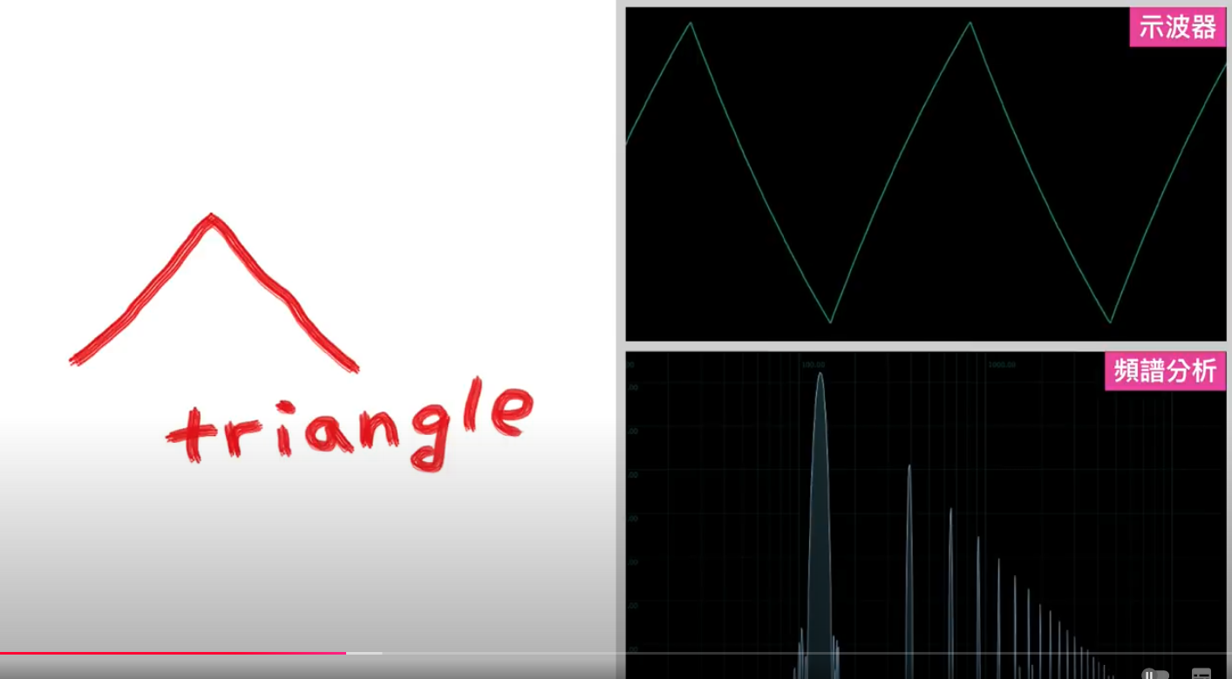
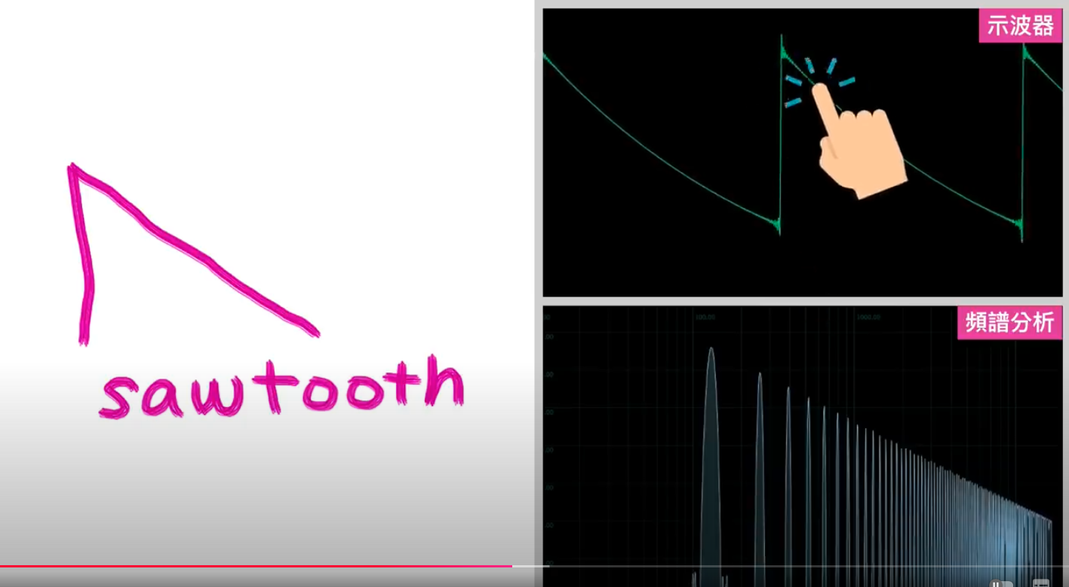
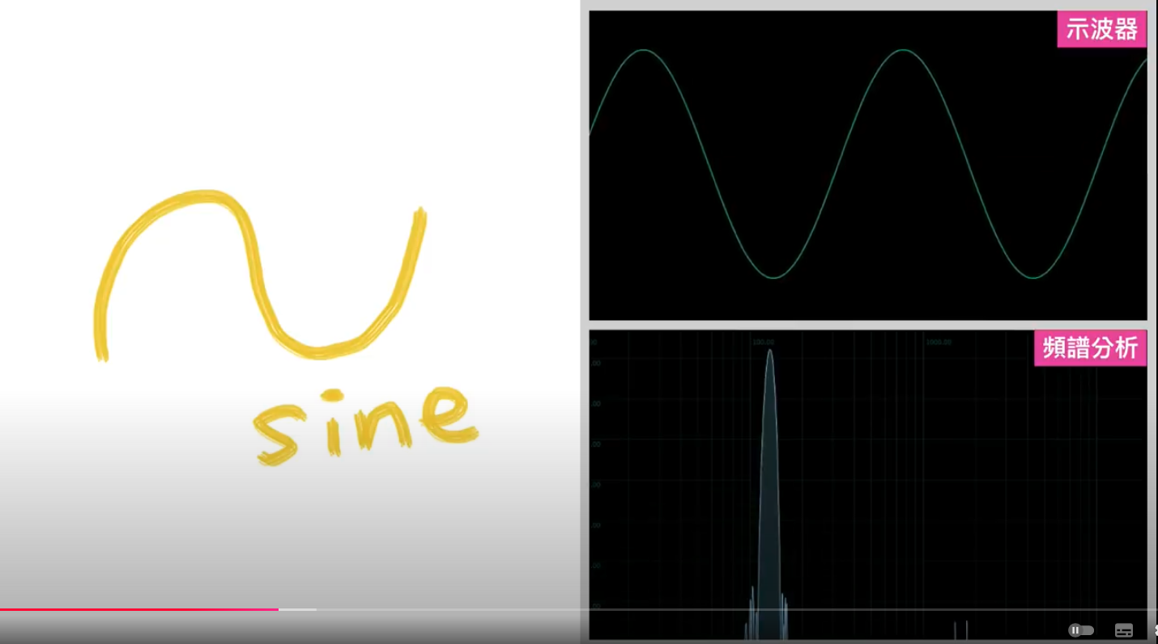
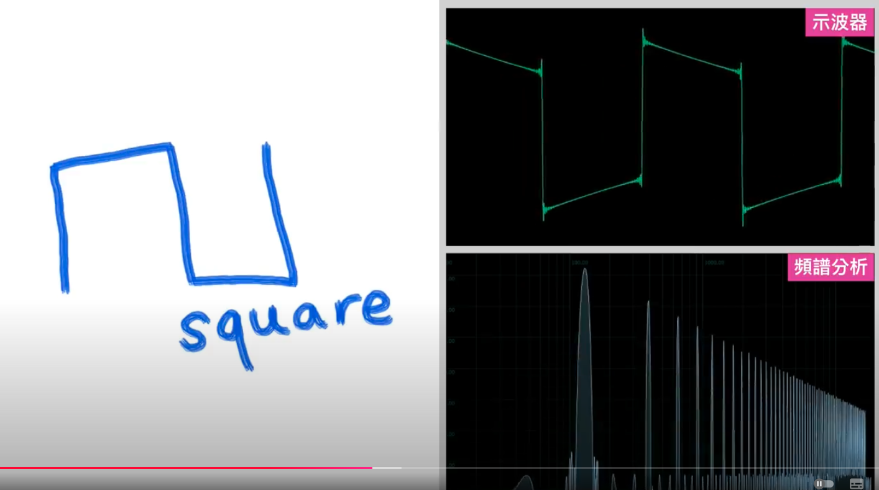

Slide 10
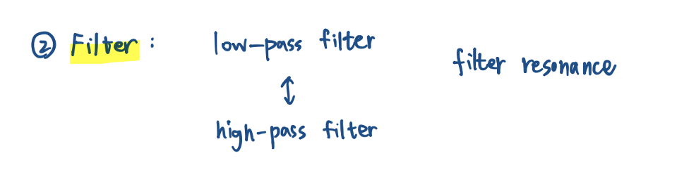

Slide 12
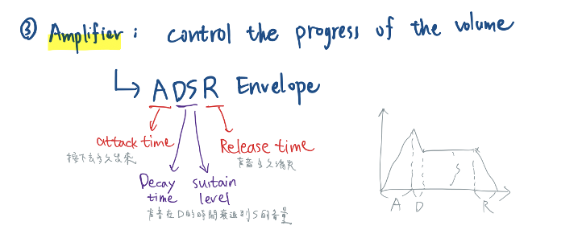

Slide 13
03
CONCEPTUAL FRAMEWORK FOR AN AI SYNTHESIZER
• How can AI generate sound based on textual descriptions?
• Example: “I want a soft and airy sound.”
• Requires extracting features from the description, like “soft” indicating a sine wave and “airy” implying low-pass filtering.

Slide 14
Traditional Sound Design Workflow
• How humans create sound:
1. Select a basic waveform (sine, sawtooth, etc.).
2. Adjust brightness and resonance using filters.
3. Set dynamic parameters like ADSR.
• Limitation: Manual design relies heavily on experience and trial-and-error.

Slide 15
AI Synthesizer Workflow
• Step 1: Analyze the input description
• Use NLP (Natural Language Processing) to extract key features (e.g., “soft”, “bright”, “metallic”).
• Step 2: Map features to synthesizer parameters
• Key features → Basic waveform:
• Example: “Soft” maps to sine wave, “sharp” maps to sawtooth wave.
• Key features → Filters:
• Example: “Dark” maps to a low-pass filter, “bright” maps to a high-pass filter.
• Key features → ADSR:
• Example: “Sustained” maps to long sustain, “snappy” maps to short attack.
• Step 3: Train an AI Model
• Workflow:
1. Generate initial sounds based on input descriptions.
2. Refine the generated sounds with user feedback using reinforcement learning or fine-tuning.

Slide 16

Other Updates
FPGA synthesizer report and paper reading
try running model and training on AHG workstation.

Slide 17

V
Thank you!
Now, what’s next?

Slide 18

Timeline
OCT.31
using juce to create an easy plugin
AI mixing or mastering:
how to collect datasets for training?
Cambridge Music Technology Multitracks
..... AI EQ?
Cambridge Music Technology Multitracks
LLM based Synthesizer

Slide 19

Special Projects
These are projects from other teams asking for our assistance.
01
02
03
UPDATE TRAINING MANUAL FOR REAL ESTATE AGENTS
DESIGN PROPERTY LISTING COLLATERALS
CREATE PROPERTY LISTING PRESENTATION TEMPLATE

Slide 20

The editorial plan includes references to updated website content, including property listings.

Slide 21

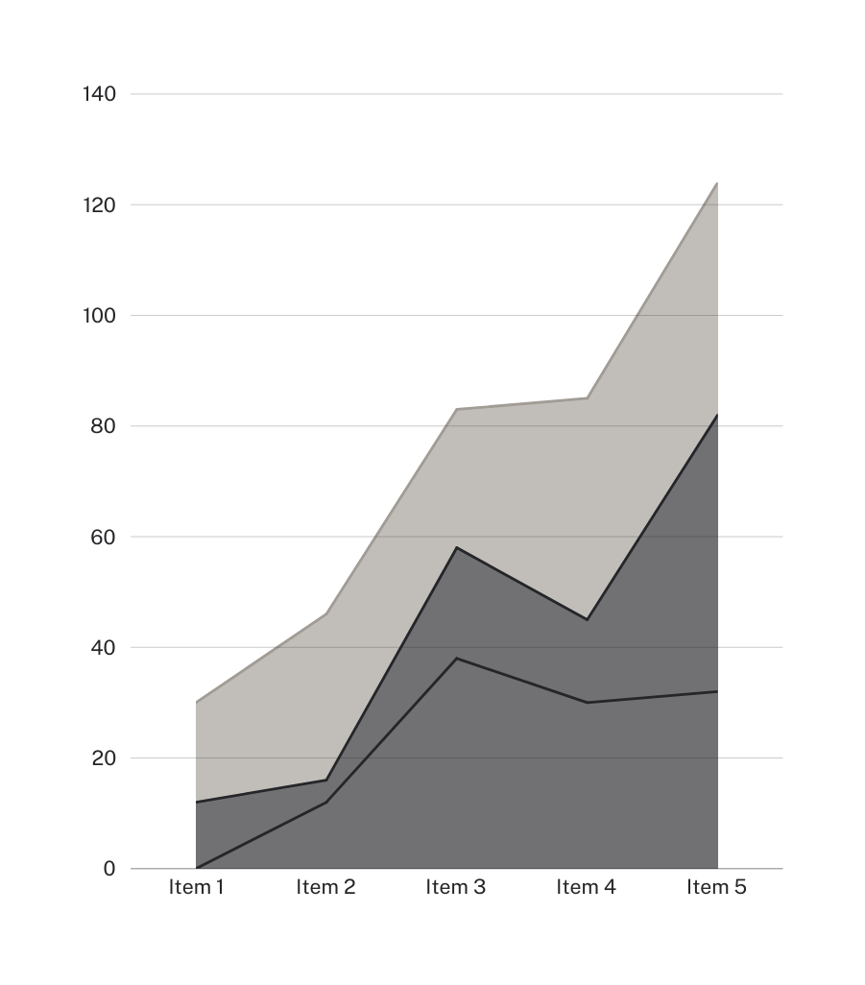
We learned
that social media posts on real estate tips are the most liked and shared.

Slide 22
Other Updates
New property listings will be posted
twice a week starting next month
The number of inquiries and appointment requests sent through the website increased by 20% after the redesign
Training manual for real estate agents
is under review by the manager

Slide 23

Action Items for Next Week
Complete blog content review
and update
Submit next month's social media editorial calendar for review
Finalize editorial calendar for the real estate newsletter

Slide 24






























Free Resources
Use these free recolorable icons and illustrations in your Canva design

